Slide 1
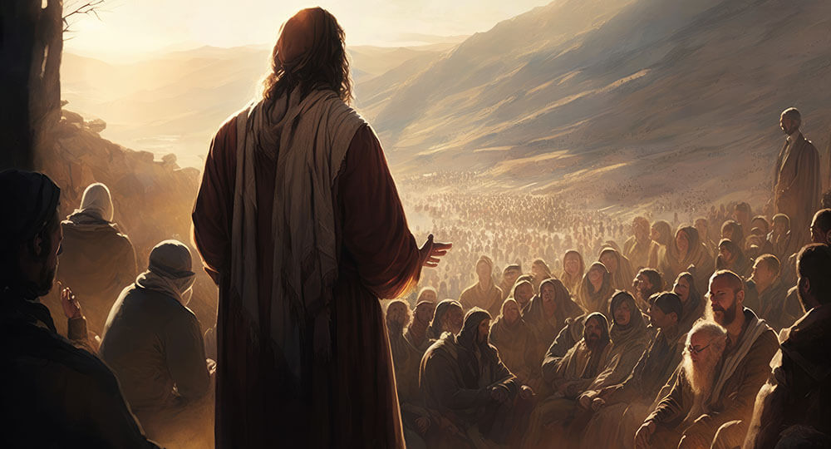
登山宝训
Notes:
Series Title Slide

Slide 2
Part 6
Loving as God loves

Slide 3
第六部分
如神一样地爱

Slide 4
Matthew 5:43 - NIV
You have heard that it was said, ‘Love your neighbor and hate
your enemy.’

Slide 5
马太福音 5:43 - NIV
你们听见有话说：‘当爱你的邻舍，恨你的仇敌。’

Slide 6
Matthew 5:44
But I tell you, love your enemies and pray for those who persecute you,

Slide 7
马太福音 5:44 - NIV
只是我告诉你们：要爱你们的仇敌，为那逼迫你们的祷告。

Slide 8
Matthew 5:45
that you may be children of your Father in heaven. He causes his sun to rise on the evil and the good,
and sends rain on the righteous
and the unrighteous.

Slide 9
马太福音 5:45 - NIV
这样，就可以作你们天父的儿子，因为祂叫日头照好人，也照歹人；降雨给义人，也给不义的人。

Slide 10
Matthew 5:46
If you love those who love you, what reward will you get? Are not even the tax collectors doing that?

Slide 11
马太福音 5:46 - NIV
你们若单爱那爱你们的人，有什么赏赐呢？就是税吏不也是这样行吗？

Slide 12
Matthew 5:47
And if you greet only your own people, what are you doing more than others? Do not even pagans
do that?

Slide 13
马太福音 5:47 - NIV
你们若单请你弟兄的安，比人有什么长处呢？就是外邦人不也是这样行吗？

Slide 14
Matthew 5:48
Be perfect, therefore, as your heavenly Father is perfect.

Slide 15
马太福音 5:48 - NIV
所以你们要完全，像你们的天父完全一样。

Slide 16
Part 6
Loving as God loves

Slide 17
第六部分
如神一样地爱

Slide 18
Part 6
Loving as God loves

Slide 19
the word “love”
The words “love” in the ancient world expressed a variety of attitudes, emotions, and behaviors. In our daily lives, love is often based on feelings.

Slide 20
世界对 “爱”的理解
在古代世界中，“爱”这个词表达了各种态度、情感和行为。在我们的日常生活中，爱往往基于感觉或感受。

Slide 21
the word “love”
The words “love” in the ancient world expressed a variety of attitudes, emotions, and behaviors. In our daily lives, love is often based on feelings.

Slide 22
agape love
The Bible introduces a different kind of love: Agape. This love is selfless and unconditional. It puts the other person's needs before our own, even when it's difficult.

Slide 23
上帝的爱
圣经介绍了一种不同的爱：上帝的爱（博爱）。这种爱是无私和无条件的。它把别人的需要放在我们自己的需要之前，即使这么做很困难。

Slide 24
John 3:16
For God so loved the world that he gave his one and only Son, that whoever believes in him shall not perish but have eternal life.

Slide 25
约翰福音 3:16
神爱世人，甚至将他的独生子赐给他们，叫一切信他的，不至灭亡，反得永生。

Slide 26
Principle #1
The key to understand God’s love is the word “gave”. God the Father gave his Son, and the Son freely gave his life so that we might live. That is the profound nature of Jesus’ love toward us, and it becomes the example of the sacrificial love that we can have for others, including our enemies.

Slide 27
Principle #1
理解上帝之爱的关键是“给予”这个词。天父赐下了他的儿子，而儿子则无偿地献出了自己的生命，以便我们能够活下去。这就是耶稣对我们的深厚爱意，也成为我们对他人（包括我们的敌人）的牺牲之爱的典范。

Slide 28
Romans 5:8
But God demonstrates his own love for us in this: while we were sinners, Christ dies for us.

Slide 29
Romans 5:10
For if, while we were God’s enemies, we were reconciled to him through the death of his Son, how much more, having been reconciled, shall we be saved through his life!

Slide 30
罗马书 5:8
惟有基督在我们还作罪人的时候
为我们死，神的爱就在此向我们
显明了。

Slide 31
罗马书 5:10
因为我们作仇敌的时候，且藉着 神儿子的死，得与 神和好；既已和好，就更要因他的生得救了。

Slide 32
Principle #2
God’s love is a motivating force that includes emotional attachment and personal feelings. We are so engaged in our enemies’ lives that we are used by God to reconcile them to Him and to bring them into alignment with God’s will for their lives.

Slide 33
Principle #2
上帝的爱是一种激励力量，包括情感依恋和个人感受。我们如此关注我们“仇敌”的生活，以至于上帝利用我们来使他们与神自己和解，并使他们的生活符合上帝对他们生命的旨意。

Slide 34
Love is a choice
Love is a choice that we make. Love is not all about how you feel. We can choose to do good for others, even when we don't feel like it. As we act in love, our feelings often catch up with our actions.

Slide 35
爱是一种选择
爱是我们做出的选择。爱与你的感受无关。我们可以选择为他人做好事，即使我们并不想这么做。当我们出于爱而行动时，我们的感觉往往会赶上我们的行动。

Slide 36
Love is a choice
Love is a choice that we make. Love is not all about how you feel. We can choose to do good for others, even when we don't feel like it. As we act in love, our feelings often catch up with our actions.

Slide 37
Principle #3
Loving someone means an unconditional commitment to an imperfect person in which we give ourselves to bring the relationship to God’s intended purpose.

Slide 38
Principle #3
爱一个人意味着对不完美的人无
条件的承诺，我们奉献自己，让
这段关系达到上帝预期的目的。

Slide 39
Principle #3
Loving someone means an unconditional commitment to an imperfect person in which we give ourselves to bring the relationship to God’s intended purpose.

Slide 40
Principle #4
There are two important clues to the
reason why we must and can love as
God loves: (1) We have a new heart of
love. (2) We have an endless supply of
God’s love by which the new heart can
continually pour forth love.

Slide 41
Principle #4
有两个重要线索可以解释为什么我
们必须并且能够像神一样去爱：
（1）我们有一颗充满爱的新心。
（2）我们有无尽的神的爱，这颗
新心可以不断地倾泻爱。

Slide 42
Ezekiel 36:26
I will give you a new heart and put a new spirit in you; I will remove from you your heart of stone and give you a heart of flesh.

Slide 43
以西结书 36:26
我也要赐给你们一个新心，将新灵放在你们里面，又从你们的肉体中除掉石心，赐给你们肉心。

Slide 44
Acts 15:9
He did not discriminate between us and them, for he purified their hearts by faith.

Slide 45
使徒行传 15:9
又藉着信洁净了他们的心，并不分他们我们

Slide 46
Principle #4
There are two important clues to the reason why we must and can love as God loves: (1) We have a new heart of love. (2) We have an endless supply of God’s love by which the new heart can continually pour forth love.

Slide 47
Principle #4
有两个重要线索可以解释为什么我们必须并且能够像神一样去爱：（1）我们有一颗充满爱的新心。（2）我们有无尽的神的爱，这颗新心可以不断地倾泻爱。

Slide 48
Principle #5
To love the way Jesus loved means our
full obedience to God’s will for our
lives, the continuing transformation of
our personal, corporate, and family
life, and our dedicated outreach to the
world around us.

Slide 49
Principle #5
像耶稣那样去爱意味着我们完全服
从上帝对我们生活的意愿，不断改
变我们的个人、集体和家庭生活，
并致力于接触我们周围的世界。

Slide 50
Full Obedience to God’s Will
Living according to God‘s will for our lives is about seeking His guidance through prayer and scripture study, and allowing Him to transform us from the inside out.

Slide 51
完全顺服神的旨意
按照上帝对我们生活的意愿生活就是通过祈祷和学习经文寻求他的指导，并让他从内到外改变我们。

Slide 52
Personal Transformation
This transformation starts with ourselves. As we grow in our faith and understanding of God's love, we become more patient, kind, and forgiving. We begin to see the good in others, even those who are difficult.

Slide 53
个人生命的转变
这种转变从我们自己开始。随着我们对上帝之爱的信仰和理解的不断增长，我们变得更加耐心、善良和宽容。我们开始看到别人身上的优点，即使是那些难以相处的人.

Slide 54
Reaching Out to the World
Reaching out to the world around us could involve volunteering our time or resources to those in need, showing kindness to strangers, or simply sharing the message of God's love with others.

Slide 55
向世界传福音
我们可以自愿为有需要的人提供我们的时间或资源，向陌生人表达善意，或者是与他人分享上帝之爱的福音。

Slide 56
My Testimony
我的见证

Slide 57
Principle #6
When we love the way Jesus loved, that is what it means to truly love
God with all our heart, soul, mind,
and strength, and our neighbors
as ourselves.

Slide 58
Principle #6
当我们像耶稣那样去爱时，这才是真正地全心、全意、全身地爱上帝，爱邻居如同爱自己。

Slide 59
Principle #6
When we love the way Jesus loved, that is what it means to truly love
God with all our heart, soul, mind,
and strength, and our neighbors
as ourselves.

Slide 60
Challenge
I challenge you to reflect on how you can put
Agape love into action in your own life.
Is there someone you need to forgive?
Is there a neighbor you could reach out to?
Who needs your kindness and compassion
today? Let's all strive to love like Jesus loved,
transforming our world one act of love
at a time.

Slide 61
生命的挑战
我鼓励你思考如何在自己的生活
中践行博爱。你需要原谅谁？你
可以帮助邻居吗？今天谁需要你
的仁慈和同情？让我们都努力像
耶稣那样去爱，用爱一点一点改
变我们的世界。

Slide 62
登山宝训
Notes:
Series Title Slide

